Slide 1
Shared Address Space Programming: Basics
Processes, Threads, Address Space, and the Operating System’s View
© 2018 L. V. Kale at the University of Illinois Urbana-Champaign

Slide 2
Processes and Address Spaces
To understand programming of multicore processors, and its performance issues, it is useful to understand:
Processes
Address spaces and their relation to real physical memory
Division of address space: global variables, stack, and heap
Operating system (OS) scheduler
Threads and their relationship to the above
Basic challenges of shared address space programming
And how (in what sequence) we want to address them in this course

Slide 3
Address Space
(Virtual Memory)
Physical Memory
Heap
Process₁
TLB
CACHE
CPU
(aka Core)
Stack
PC, SP
Registers
Global Variables
Process₂

Slide 4
Address Space
(VM)
Heap
Process₁
Physical Memory
Process₁
Stack
TLB
CACHE
CPU
(aka Core)
Global Variables
Saved PC, SP
Registers
Saved PC, SP
Registers
PC, SP
Registers
Process₂
Process₂
Notes:
2 processes, 2 address spaces, one core
Show (sacved) PC/registers inside each process, animate context switch

Slide 5
Processes and Time Sharing
A process’ view of memory is its address space. Its “logical” or “virtual” memory
Pages from virtual memory are assigned to (live in) pages of physical memory
OS runs a process for a time-quanta (a few milliseconds) and then interrupts it, so it can run another process, if any
As well as short OS services, daemons
This is called a context switch
Registers, including PC (program counter) and SP (stack pointer), as well as data registers, are saved in memory when a process is context switched out
When there are multiple processes
Note that when the same process is scheduled again:
The cache may not contain data you had brought in earlier
From your process’s point of view, the cache is said to be “polluted”
Of course, your data is safe in memory (eviction handles that)
Notes:
Recap: concepts and vocabulary

Slide 6
Process₁
Heap
TLB
Address Space
(VM)
Physical Memory
Stack
CPU 1
(aka Core 1)
CACHE
Global Variables
PC, SP
Registers
Process₂
Heap
Address Space
(VM)
Stack
TLB
Global Variables
CPU 2
(aka Core 2)
CACHE
Process₃
Heap
PC, SP
Registers
Address Space
(VM)
Stack
Global Variables

Slide 7
OS Visible Threads
To write parallel programs on a multicore processor (aka Node)
You can’t quite have two processes running on two cores
Because each will run on its own address space. So no coordination and no “shared memory programming”
Instead, let us a have something smaller than a process
LWP (light-weight process), pthread (POSIX thread), Windows threads, fibers
We will talk about pthreads, but the same idea applies to Windows, etc.
Each process “contains” several pthreads
They all share the same address space
Pthreads are visible to operating systems (OS) for the purpose of scheduling
I.e., a pthread is like a process, from the point of view of scheduling, but subordinate to (or part of) a process in that all pthreads belonging to a process have the same shared address space

Slide 8
Address Space
(VM)
Common Heap
TLB
Physical Memory
CPU 1
(aka Core 1)
Thread₁
CACHE
PC, SP
Registers
Stack
Thread Local Storage
Thread₂
TLB
CPU 2
(aka Core 2)
CACHE
Stack
PC, SP
Registers
Thread Local Storage
Common Global Variables
Notes:
Add 2 cores, 3 processes
Explain scheduling

Slide 9
OS Visible Threads
When you are writing a tightly coupled, performance-oriented parallel program, you do want to keep each pthread running on one fixed core
To the extent possible
So there is no cache pollution
You can try to keep the “working set” of each thread within the caches
Recall: working set is the subset of memory that the program is accessing at the current time
Corollary: over-subscription (more pthreads than cores) is bad
BTW: there are other situations, such as some web-server programs, where this affinity is a non-issue
Time scales maybe shorter than OS quanta
Disk I/O times may dominate
Over-subscription may be ok, if many threads are waiting for their I/O
From disk or network

Slide 10
Simultaneous Multi-threading (SMT) / Hyperthreading
Most machines today support two-way SMT
Although the word “thread” is used, this has nothing (directly) to do with the OS-visible threads we saw (pthreads, etc.)
A two-way SMT means each core can be thought of as two cores
It has two sets of registers, including PC, SP (so it is executing its own instruction stream)
But shares floating point unit/s, L1 caches, etc.
When one hardware thread is waiting (e.g., for a load or a floating point operation), the other thread runs
So, you will get close to a two-fold speedup only when each thread is running code that has a lot of such “waiting” (latencies)

Slide 11
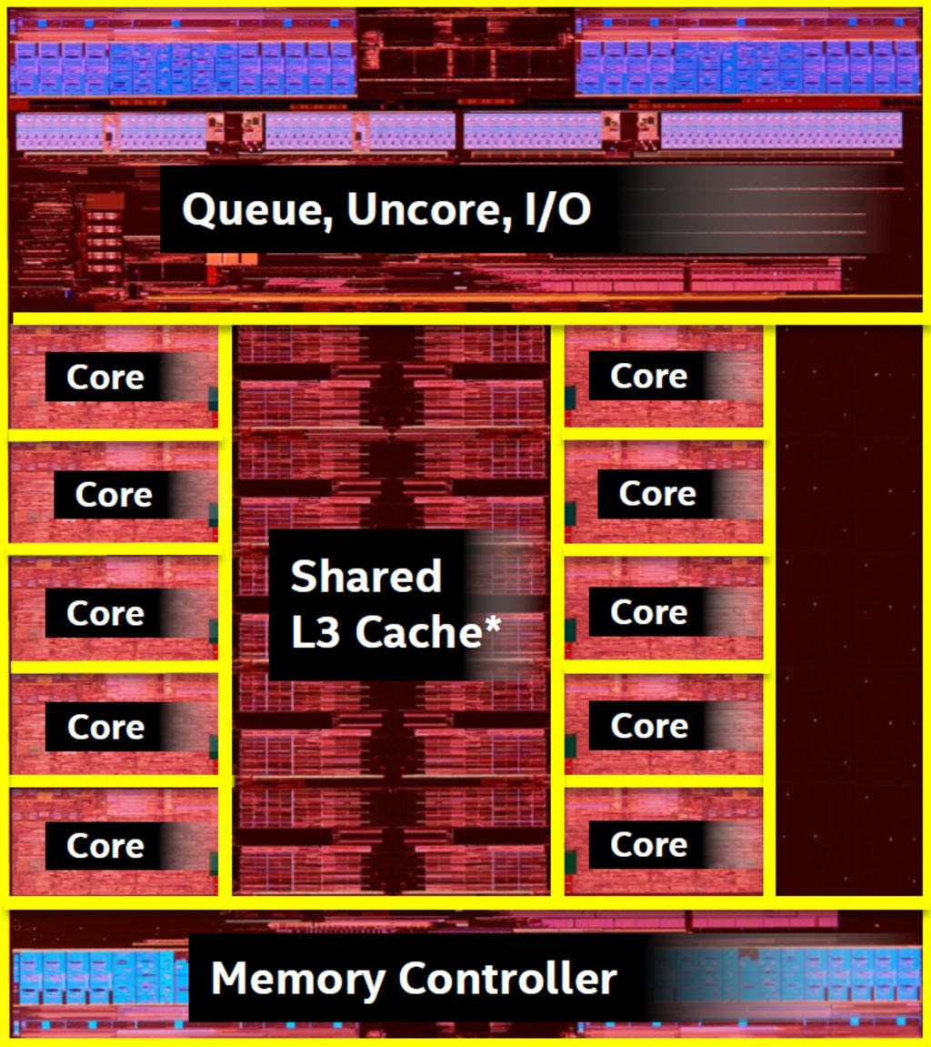
A Little More on Hardware Hierarchy
“System” or “host” or “node” or “box,” may contain multiple processors
Node is a term that comes from clusters and supercomputers, which include many such nodes connected by some network (Infiniband, ethernet, or proprietary network)
Processor or socket: a single chip, may contain multiple cores
Core: may contain two-way or four-way hardware threads
Memory:
L1 cache private to a core (or two)
L2 may be private or shared
L3 shared (across all processors in a node)
Memory controller, typically one per chip
Chip1
Chip1
DRAM
Intel Broadwell chip
Source: PCWorld / https://goo.gl/fcyXAP
Notes:
Hierarchy of hardware

